Slide 1
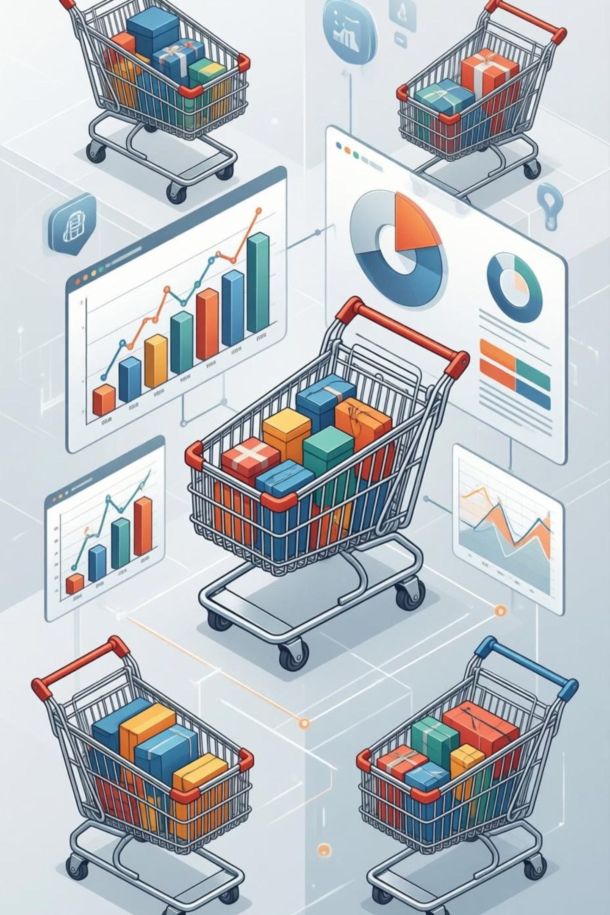
Customer Shopping Behavior Analysis
Analysis of 3,900 Customer Transactions
Tools: Python | SQL Server Express (SSMS) | Power BI

Slide 2

Project Overview
Analyze Customer Shopping Behavior
Deep dive into transaction data to identify key trends and patterns in customer interactions.
Understand Spending Patterns & Preferences
Uncover what customers buy, how much they spend, and their preferred shopping methods.
Support Data-Driven Business Decisions
Provide actionable insights to optimize marketing, product development, and operational strategies.

Slide 3




Dataset Summary
Total Records: 3,900
Key Data Categories
Total Columns: 18
Our analysis is based on a comprehensive dataset of nearly 4,000 customer transactions, providing a robust foundation for insights.
Customer Demographics
Purchase Details
Shopping Behavior

Slide 4

Data Preparation using Python
01
02
Data Loading with Pandas
Handling Missing Review Ratings
Efficiently ingested raw transaction data into Python using the Pandas library for initial processing.
Implemented strategies to address and impute missing values in customer review ratings to ensure data completeness.
03
04
Column Standardization (snake_case)
Ensured Data Consistency
Standardized column names to snake_case for improved readability and consistency across the dataset.
Performed rigorous checks and transformations to maintain the integrity and accuracy of the dataset.

Slide 5




Feature Engineering
Transforming raw data into meaningful features to enhance model performance and uncover deeper insights.
Created 'age_group' Column
Calculated Purchase Frequency
Segmented customers into distinct age brackets to analyze age-specific shopping trends.
Derived a metric to understand how often customers make purchases, aiding in loyalty assessment.
Removed Redundant Promo Code Feature
Eliminated features that did not contribute significant value, streamlining the dataset for analysis.

Slide 6

Database Integration
Cleaned Data Stored in SQL Server Express
Queries Executed Using SSMS
Post-Python processing, the refined dataset was securely uploaded to SQL Server Express.
Leveraged SQL Server Management Studio (SSMS) for executing complex queries and data retrieval.
Enabled Structured Business Analysis
The SQL database provided a robust framework for structured analysis, ensuring data integrity and accessibility.

Slide 7
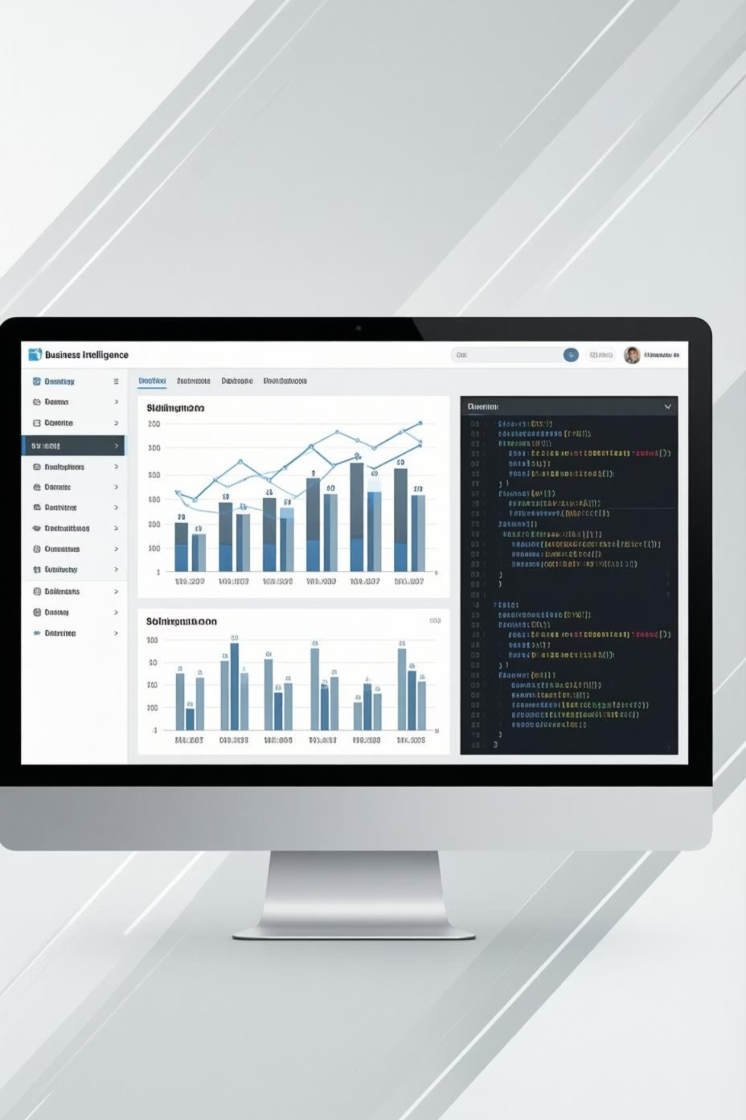
SQL Business Analysis
Leveraging SQL queries to extract critical business insights from the refined dataset.
1
Revenue by Gender
Analyzed purchasing power and preferences across different gender demographics.
2
Subscribers vs. Non-Subscribers
Compared spending habits and loyalty between subscribed and non-subscribed customer segments.
3
Shipping Type Comparison
Evaluated the impact of various shipping methods on customer satisfaction and purchase frequency.
4
Revenue Contribution by Age Group
Identified which age segments drive the most revenue, informing targeted marketing strategies.

Slide 8

Product & Customer Insights
Key Product Discoveries
Customer Segmentation
Top 5 Products by Review Rating: Identifying products with the highest customer satisfaction.
New Customers
Discount-Dependent Products: Pinpointing items that significantly benefit from promotional pricing.
First-time purchasers
Returning Customers
Repeat buyers
Loyal Customers
Frequent, high-value purchasers

Slide 9
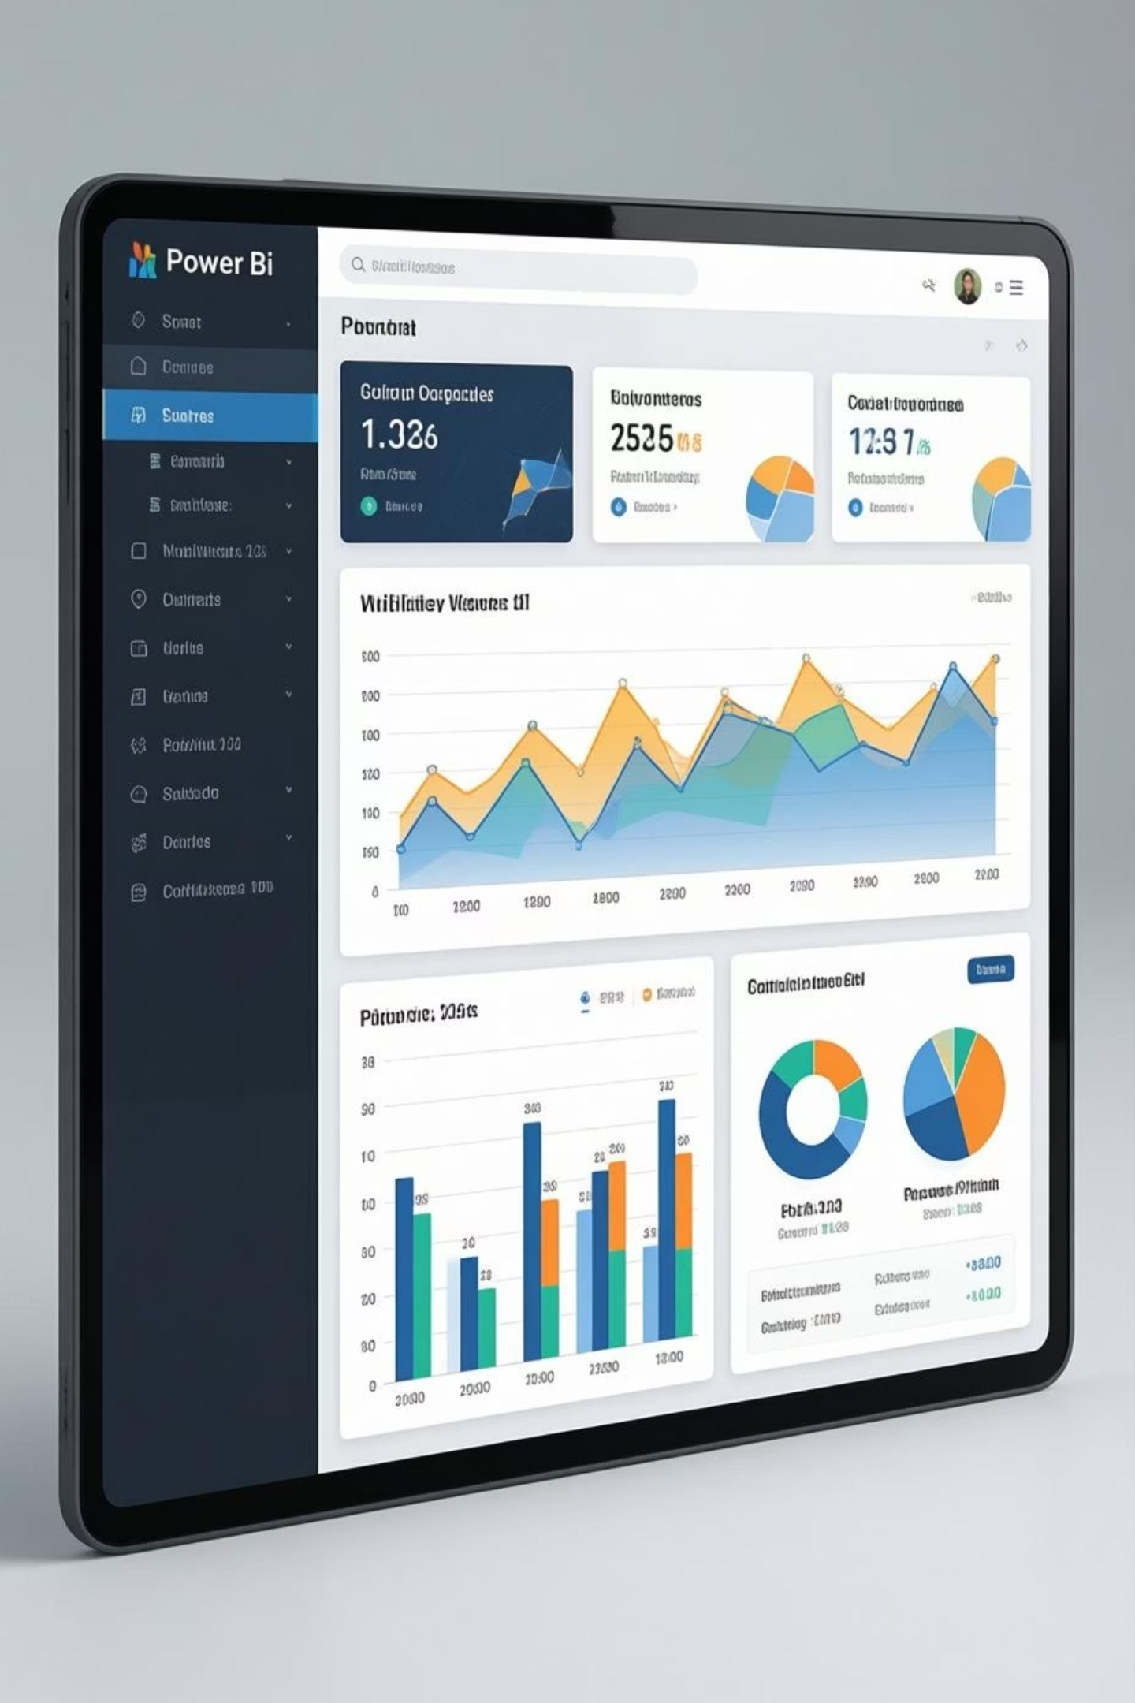


Power BI Dashboard
An interactive and dynamic dashboard for real-time business insights.
Interactive Business Dashboard
Key Performance Indicators (KPIs)
Showcases critical metrics: Total Revenue, Average Ratings, and Purchase Amount.
Provides a visual, easy-to-understand interface for exploring complex data.
Dynamic Filters
Allows users to filter data by Age, Gender, Product Category, and Subscription Status for granular analysis.

Slide 10





Recommendations & Conclusion
Promote Subscription Plans
Increase customer lifetime value and recurring revenue.
Introduce Loyalty Programs
Reward and retain valuable returning and loyal customers.
Optimize Discount Strategy
Strategically apply discounts to maximize sales and profitability for specific products.
Focus on High-Performing Products
Invest in and market top-rated products that drive customer satisfaction.

